Slide 1
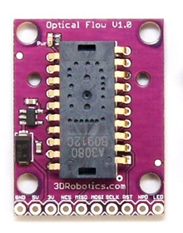
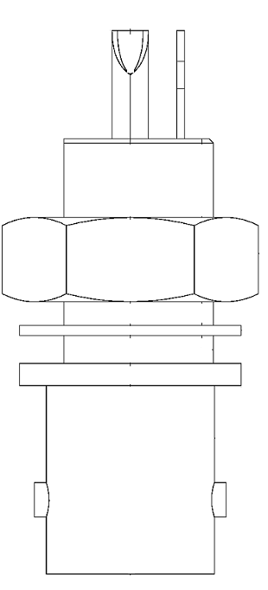
USB programming port connection to PC running Matlab
39 ohm Resistor
OP290A (IR LED)
Use 9V external power supply
To ground lugs on BNC panel connectors
Long LED leg
Y velocity (BNC)
X velocity (BNC)
39 ohm Resistor
OP290A (IR LED)

